Slide 1
Design of bankrate.com
By Scott Coughlin

Slide 2

Background Information
Summary:
This website helps calculate your monthly mortgage payment based on the house cost and how much you pay.
Number of Employees
Bankrate has 384 employees.
Annual Revenue
Bankrate generates $434.2M in revenue.

Slide 3

User Base
Targeting wide audience
First time home buyers who might not know how to calculate their mortgage
People coming out of college who are trying to find a place to live that they can afford.

Slide 4
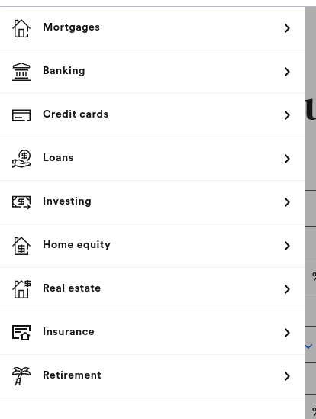
What web pages they include in their site
They have these different tabs on the side that you can click to find other kinds of calculators. Although the mortgage one is the one I am focusing on, by pressing each of these, you can calculate other things.

Slide 5

Accessibility Design
Pros
Website allows you to ask questions
Allows you to change between U.S and U.K
Does not sell info
Easy to put in information
Allows anyone to check instantly
Doesn’t have any restrictions
Cons
Doesn’t let you change language.
No resize text

Slide 6
User Flow
This company has a lot of people who come to the website to check their info. People will come to this website to easily and quickly check their data.

Slide 7
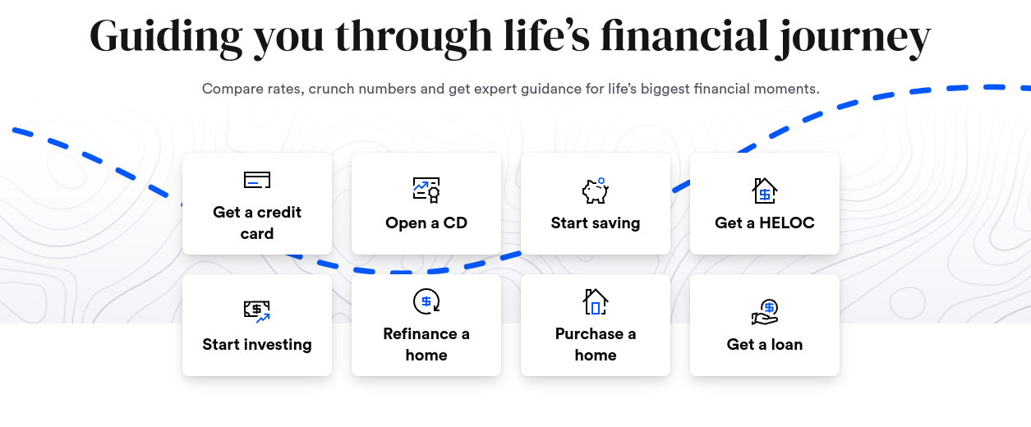
Design of Homepage/Start Screen
The design of the home screen allows you to easily find the calculator that you want. There is no trouble that can be caused while trying to find what you want unless it doesn’t load.

Slide 8
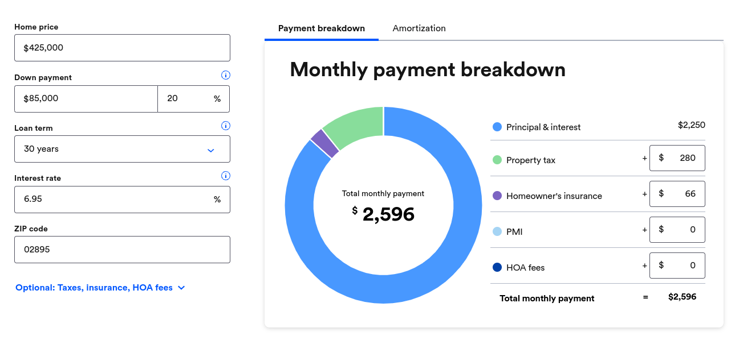
Interactive Design
The website shows you the different payments that you will have to pay. It used the wheel to make it easier to understand what percent of the amounts are in what areas.

Slide 9
The payment experience (If applicable)
No payment needed

Slide 10
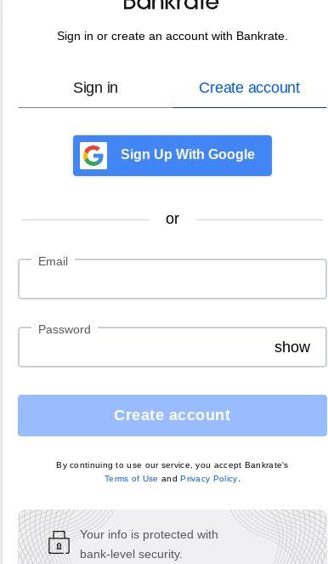
User signup
The user sign up is very simple
You can do it through your gmail or by just putting in any other valid email and password.

